Slide 1
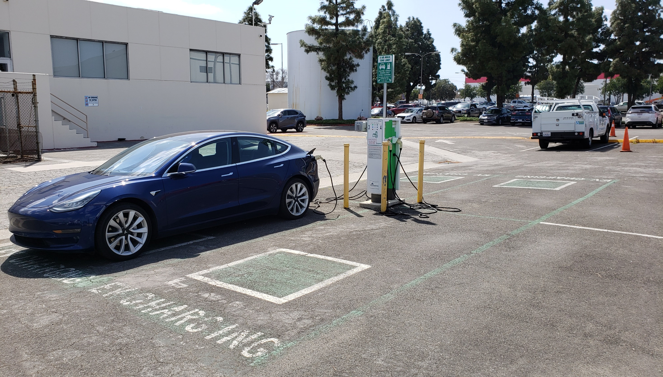
Liberty Plugins Code Control Module
Non-Network Access Control for Electric Vehicle Charging
Presented by: Michael Keane, CTO Chief Technology Officer
Liberty Access Technologies
Siemens eMobility EV Charging Solutions V1.0
Notes:
1

Slide 2
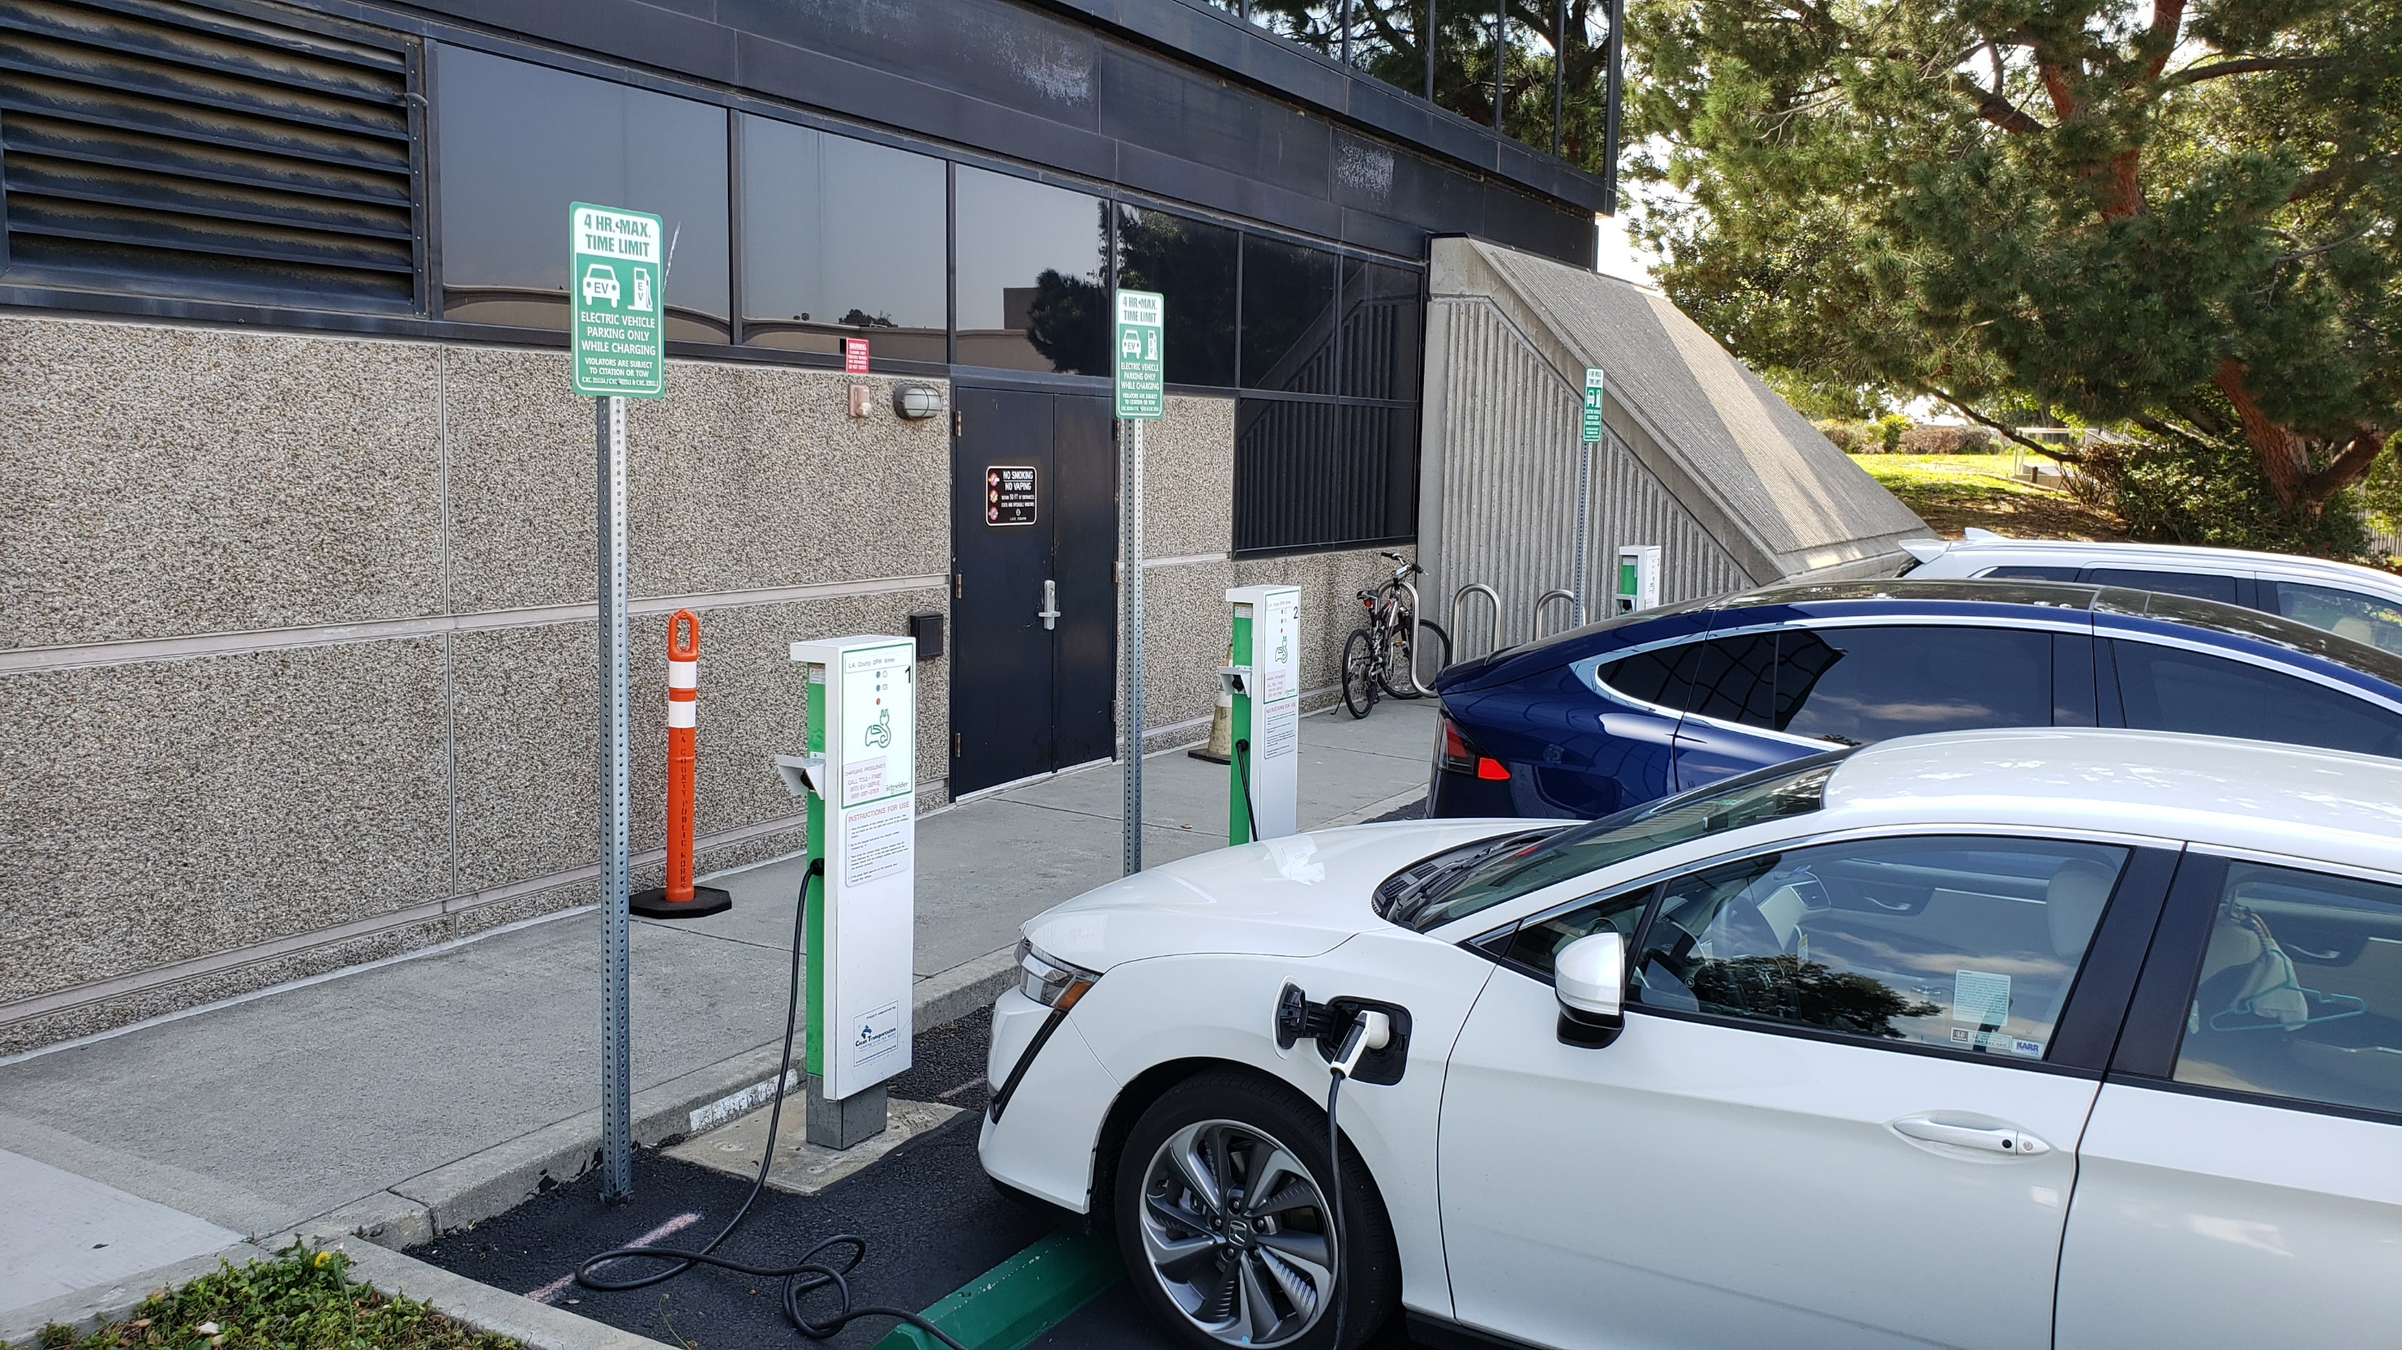
Table of contents:
Liberty PlugIns EVSE Control Systems 3
LPI’s Synchronous Codes 4
LPI Code Control Module 5
Liberty PlugIns 7
PayByMobile EV Charging 8
PayByMobile 9
Contacts 10
2
Notes:
2

Slide 3
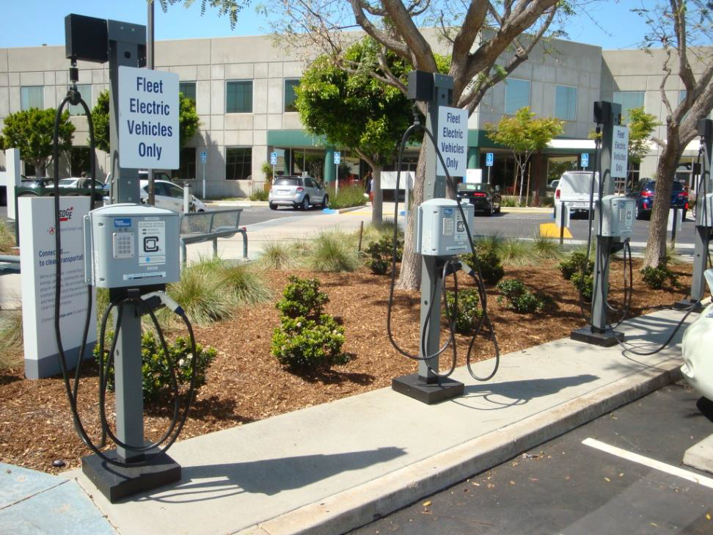
Liberty Plugins EVSE Control System
LPI adds Network EVSE features to basic Chargers:
Access Control
Data Recording
Communications
Energy Management
Open Standards
Gives Station Owners Control of theirs Chargers and Customers
“Liberty Enabled” ClipperCreek CS-40s with Code Control Modules
3
Notes:
3
3

Slide 4
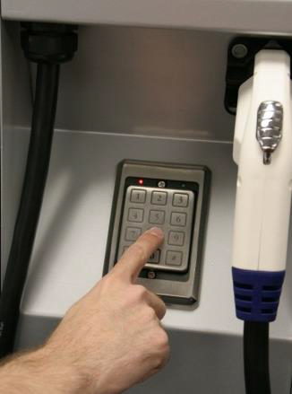
LPI’s Synchronous Codes
Access Control without the Network!
The system uses a common clock to generate the charging and clock synch codes.
The code is entered into the keypad on the charger.
A decoding algorithm verifies the code and enables the charging session.
Ideal for remote locations where cellular reception is poor.
4
Notes:
4
4

Slide 5
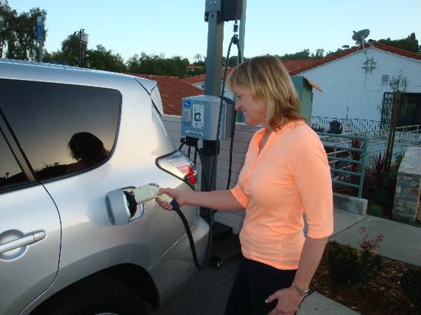
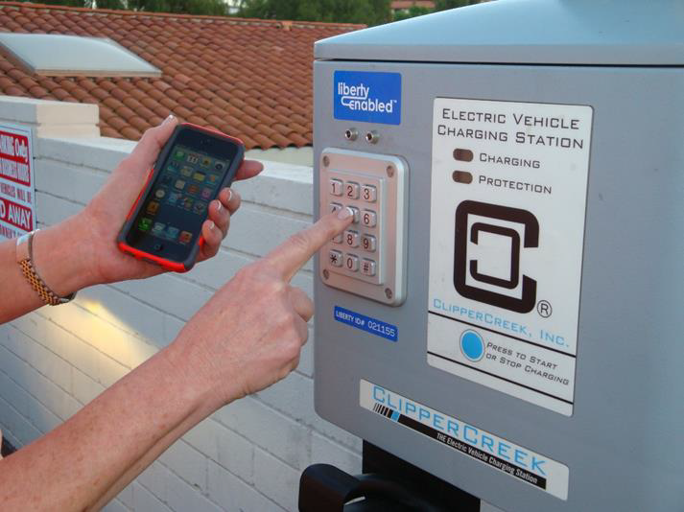
LPI Code Control Module
1. Park and plug in cable to your EV
2. Enter Charging Code
Charging stops when End Time is reached or the EV is fully charged
5
Notes:
5
5

Slide 6
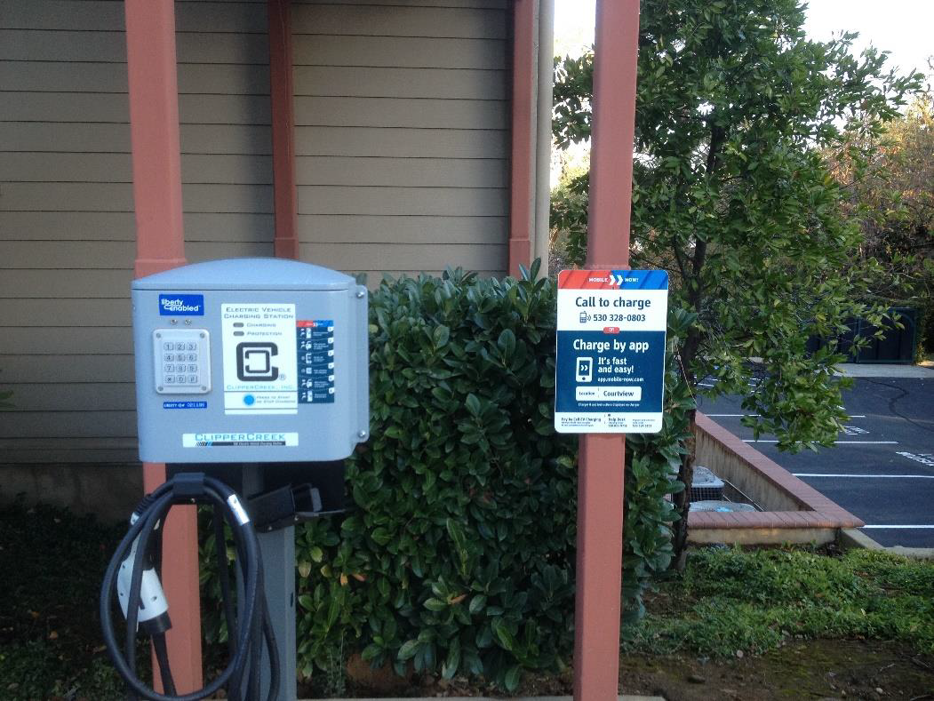
LPI Code Control Module
Billing Choices For EVSE Owners
EVSE Owner Controls the billing system and rates
Use your existing billing systems (gift shops, monthly rent, payroll deduction)
Optional PayByMobil smartphone billing system available
6
Notes:
6
6

Slide 7
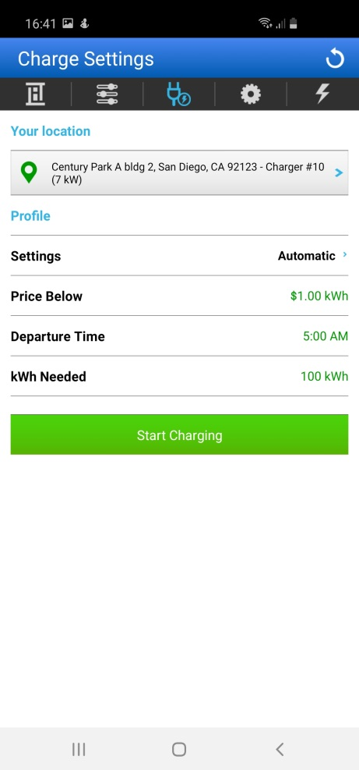
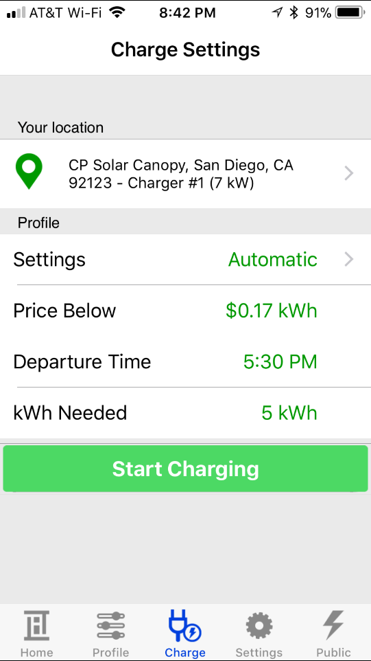
Liberty PlugIns
PayByMobile Optional Billing System
No Proprietary Billing or Subscriber
Use your existing billing systems (gift shops, monthly rent, payroll deduction)
Optional PayByMobil smartphone billing system available
7
Notes:
7
7

Slide 8
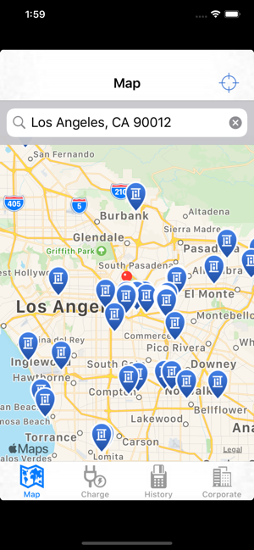
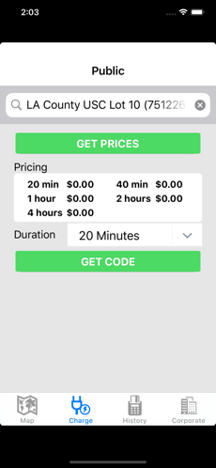
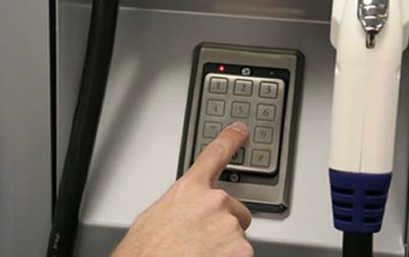
PayByMobile EV Charging
1. Park and plug in cable
into you EV
2. Launch Liberty Hydra App
6. Charging revenue* and usage reports sent to EVSE owner
*Less card processing fee
3.Enter EVSE
ID#/ZIP/Address
4. Founds deducted and
code generated
5. Enter Charging Code
8
Notes:
8
8

Slide 9
PayByMobile
Cost Effective Billing Solution for EV Charging
EVSE Owner
Set Up Account
Set Fees
Create Signage
Owner Receives
100% of revenue minus credit card processing fees*.
Customer
Download App
Create Account
Customer Pays
EV charging fee (set by owner) plus a convenience fee
Driver launches app, enters charger # and select EV charging time
*Code Access Fee $9/mo/EVSE
9
Notes:
9
9

Slide 10
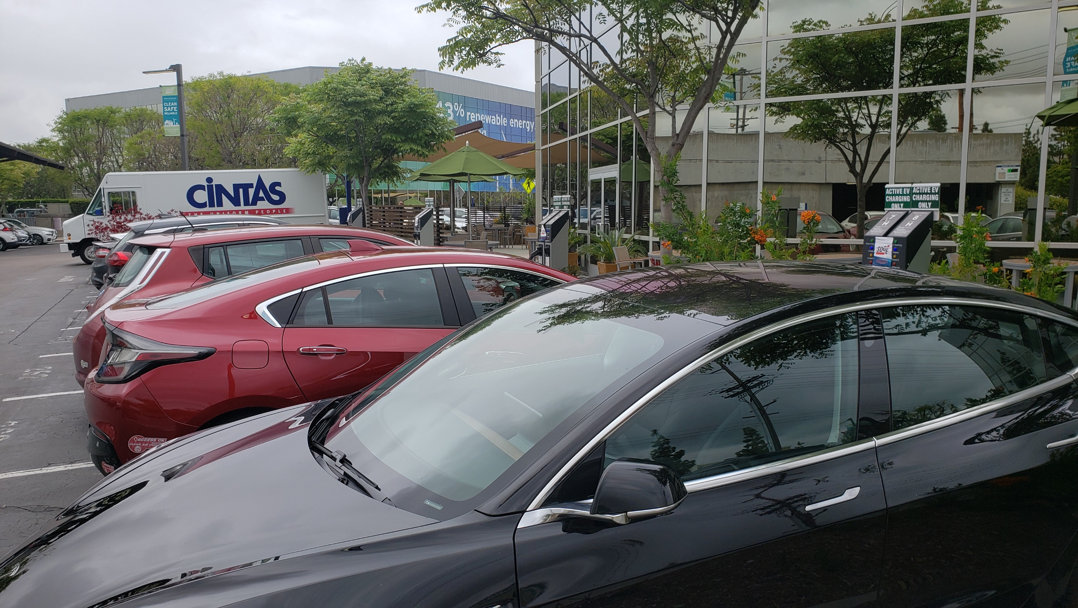
Chris Outwater
Karen Banuelos
President
Administration
Assistant to Michael Keane, CTO
(805) 886-3300
chris@libertyplugins.com
(949) 677-1845
karen@libertyplugins.com
info@libertyplugins.com
https://www.libertyplugins.com/
https://www.lataccess.com/
https://apps.apple.com/us/app/liberty-hydra/id820987748?ign-mpt=uo%3D4
https://play.google.com/store/apps/details?id=com.libertyhydra.libertyhydramobile
Siemens eMobility EV Charging Solutions V1.0
Notes:
10

